Slide 1
Digestive System

Slide 2
Oral cavity and Pharynx
The oral cavity and pharynx are lined by a stratified squamous epithelium containing abundant mucus-secreting cells.
The tongue:
Poorly developed and reveals absence of specific
Muscles. usually appears as a mucosal thickening without muscular fibers.
The epithelium: Contains several layers of cells within taste buds and unicellular gland cells are distributed.
lamina propria: Thick

Slide 3
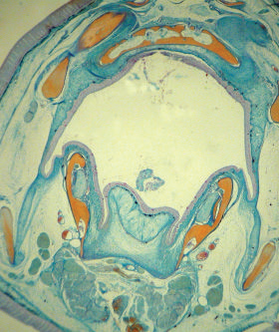
The tongue

Slide 4
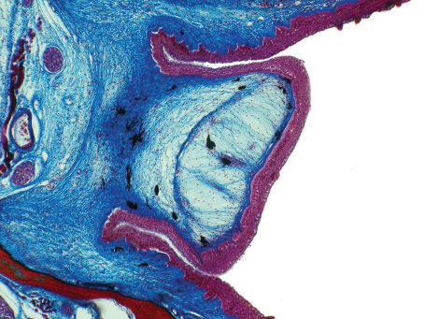
The Tongue with taste bud

Slide 5
Esophagus
In general view, the mucosal epithelial folds containing a huge amount of goblet cells (= mucous cells, unstained).
The lamina propria
Muscularis mucosae: absent
submucosa
the submucosa are more or less separated by some fasciculi
Muscularis Externa: comprising interweaving striated muscle fibers that may extend as far as the stomach

Slide 6
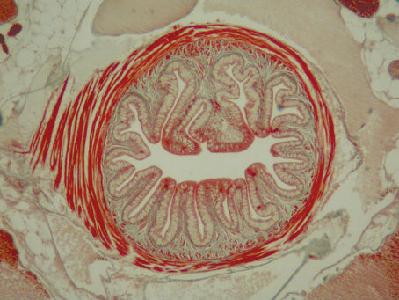
The esophagus

Slide 7
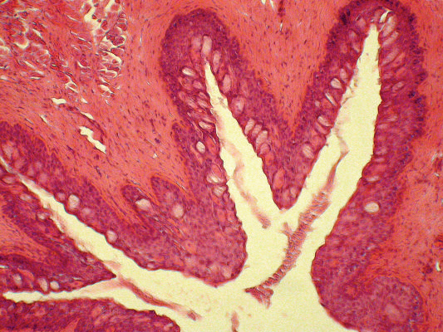
*
*
Numerous mucous cells (unstained - arrows) supported by a mixed lamina propria-submucosal layer (*) considering the absence of a true muscularis mucosae.

Slide 8
Cells of esophagus
1- Various layers of the epithelium are single secretory cells which release large amounts of neutral and acidic glycoconjugates which could have a role in the lubrication of the epithelium, in the interaction between mucosa and viruses or bacteria.
2- chloride cells

Slide 9
A view of a broad fold of the anterior esophagus showing mucous cells (short arrows).
large chloride cells (long arrows) can be found at this level of the digestive tract.

Slide 10
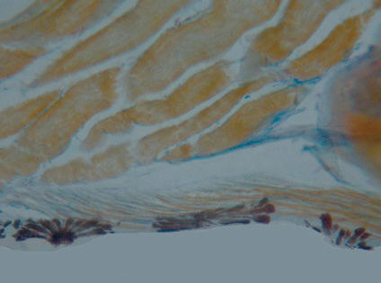
Serosa
The serosa actually begins where the gut enters the peritoneal cavity (*). This photomicrograph emphasizes the presence of chromatophores (in black) within the parietal layer (squamous epithelium) of the peritoneum. In orange, rhabdomyocytes of the dorsal musculature.
*

Slide 11
Stomach
Shape: The stomach of teleosts presents a variety of different shapes. In some teleosts, the entire gut appears as a tube of uniform diameter with no marked anatomical differences between the esophagus and stomach. In others, it appears as a round and muscular structure situated at the end of the esophagus. In a few others, the stomach can be divided into a cardiac and a pyloric part and possesses a blind sac of variable size, lying between the two.

Slide 12
Stomach
Epithelium: Single-layered mucous– mucus in grey-blue) lining this organ. Invaginagtions occurred of the epithelium to form the gastric pits.
gastric glands are lined with a single type of secretory cell and extend throughout the sub-epithelial.
lamina propria: connective tissue.
Muscularis mucosae: is obvious and has the collagen in the submucosa is stained turquoise.
submucosa: surrounded by the two smooth muscular layers of the muscularis .
A large vein with numerous blood cells is shown.

Slide 13
Many fish like the guppy are stomachless : the intestine directly connects to the pharynx through a short esophagus.

Slide 14
Cells of stomach in fish
Oxyntopeptdic cells
acidophilic granules and produces both pepsin and hydrochloric acid
Large numbers of eosinophilic granule cells.
The function of these granule cells is uncertain, but they appear to have a role in body defense mechanisms, especially with Infectious Hematopoietic Necrosis Virus (IHNV).

Slide 15
*
*
1

Slide 17
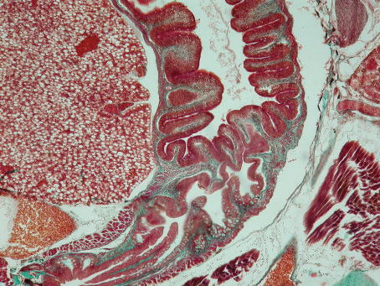

Slide 18
The intestine
Shape: The intestine of most fish is a simple tube which does not increase in diameter to form a colon posteriorly. In contrast to mammals there is no marked distinction between small and large intestines. Generally, straight, sigmoid or coiled, depending on the shape of the abdominal cavity.
fishes Intestinal length is variable, carnivorous species often have shorter intestines than herbivorous fish, and in these latter extensive coiling takes place.
It has a simple, mucoid, columnar epithelium, overlying a submucosa often with abundant

Slide 19
Epithelium: simple or pseudostratified columnar type. Ciliated cells occurring among the ordinary prismatic cells of the intestine.
Lieberkuhn: absent.
The terminal section of the intestine iusually slightly widened into a rectum.
The anterior part of the intestine close to the pylorus. These blind-ending structures are the pyloric caeca, (They possess a multi-folded intestinal type epithelium and seem to be chiefly a device for increasing the area for the absorptive processes and the duration food stays in the intestine.

Slide 20
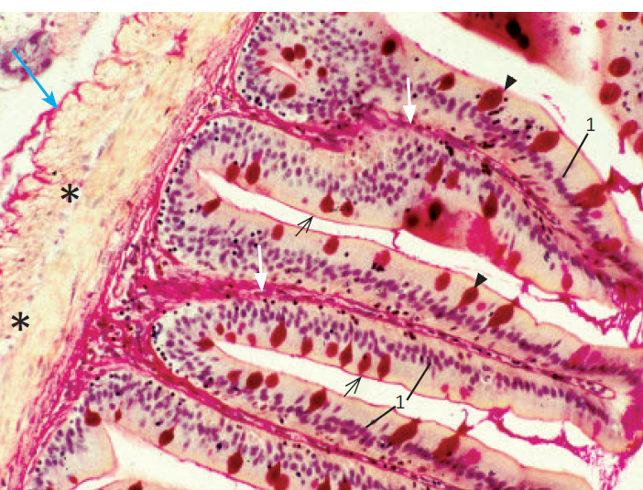

Slide 22
GLANDS ASSOCIATED WITH THE GASTROINTESTINAL TRACT
LIVER
The histology of fish liver differs from the mammalian in that there is far less tendency for disposition of the hepatocytes in lobules and the typical portal triads of the mammalian liver are rarely seen.
Macrophagic kupffer cells are not found in teleosts, although cells capable of ingesting foreign particles were described among the hepatocytes of a few species.

Slide 23
The hepatic structure normally varies (and considerably) in direct relationship to gender, age, available food (especially with regard to glycogen and fat content), or temperature, and with endocrine influences strongly connected to the environmentally regulated breeding conditions.

Slide 24
Pancreas
There are two general basic types of fish livers those that contain pancreatic tissue versus those that do not. Fish livers with exocrine pancreatic tissue are often called “ hepatopancreas.
The pancreas is generally diffusely spread within the fat and mesenteries that connect the intestine,
stomach, liver and gall bladder.

Slide 25
It is composed of exocrine and endocrine tissues. The exocrine pancreas
consists of clusters of pyramidal cells mostly organised in acini as observed in mammals.
The cells have a dark basophilic cytoplasm,
distinct basal nuclei, and many large eosinophilic zymogen granules.

Slide 26
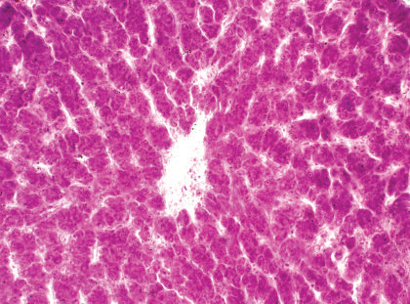
Liver
Vein

Slide 27
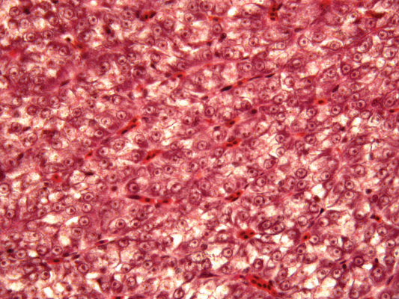


Slide 28
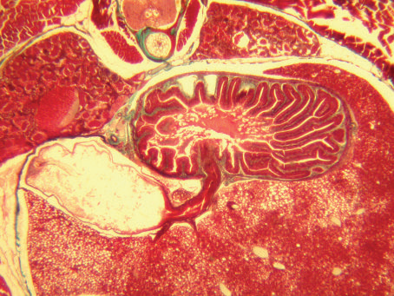
Gall bladder
3
1
2

Slide 29
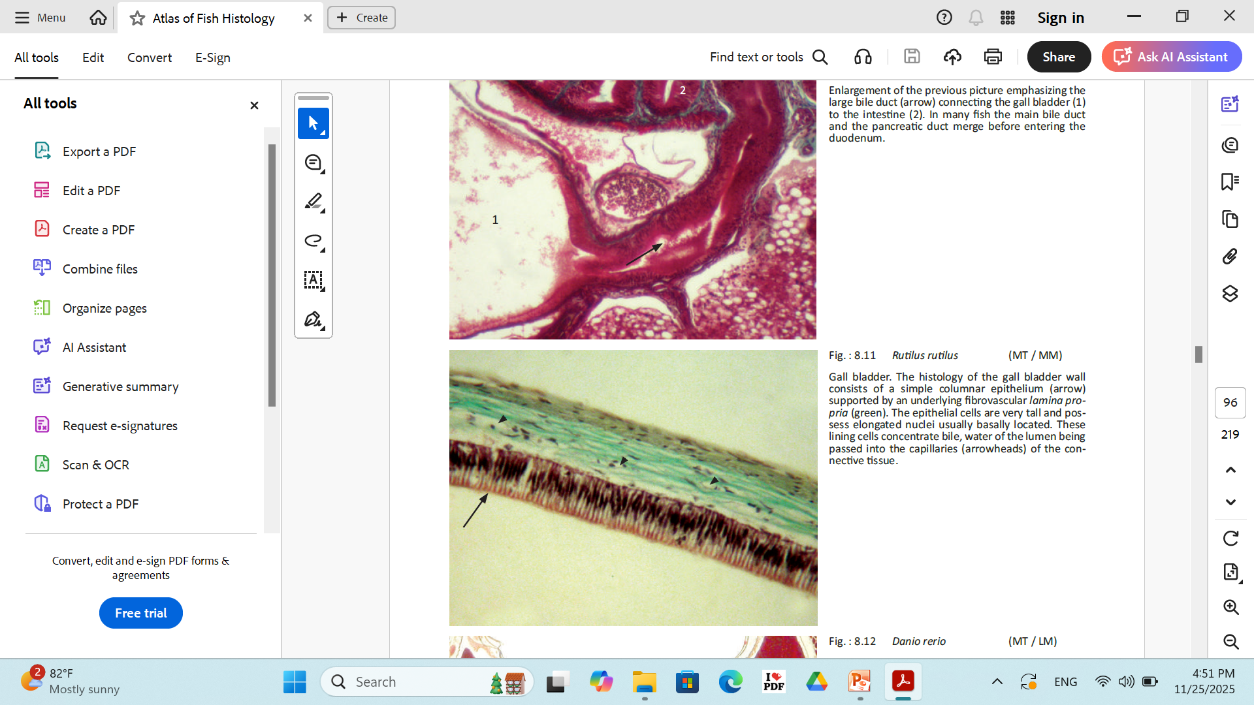
Gall bladder

Slide 30
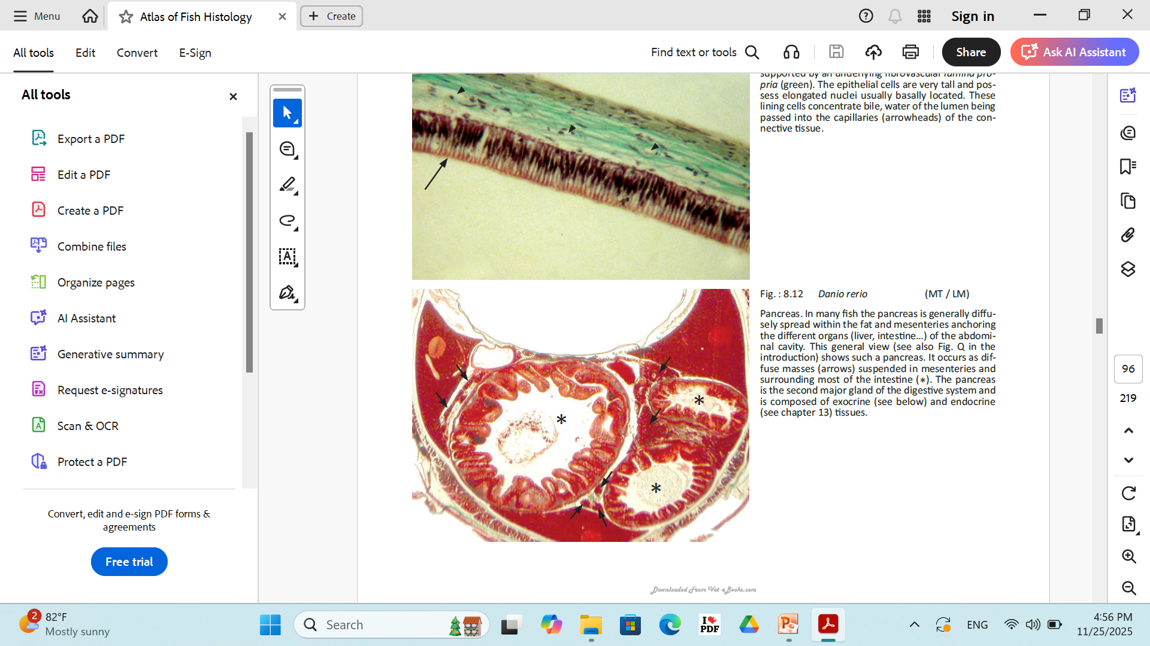
Pancreas

Slide 31
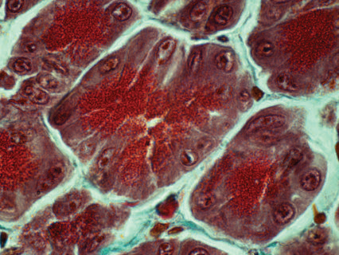
Pancreas

Slide 32
Respiratory System
Gills
Skin
pharyngeal and buccal diverticula
intestine

Slide 33
Respiratory System
Gills and Pseudobranchs
Epithelium: thin with a large surface area in order for a high level of exposure of gill capillaries to water.
Function:
Gas exchange of oxygen absorption and carbon dioxide.
Regulating the exchange of salt and water and play a major role in the excretion of the nitrogenous waste products, primarily ammonia.

Slide 34
THE GILL ARCH & PRIMARY LAMELLAE
The gill arch is a curved osseous, or bony, structure from which radiate double rows of paired primary lamellae or filaments.
Each of these primary lamellae has a series of secondary lamellae located perpendicular to the primary lamellae.

Slide 35
The primary lamella is covered by a mucoid epidermis which may have within it pale staining saline, or salt secreting called chloride cells. These chloride cells are most numerous at the basal (proximal) part of the lamellae.
Function of chloride cells: Ionic transport with a possible role in detoxification.

Slide 36
THE SECONDARY LAMELLAE
Gaseous exchange takes place across the surface of the secondary lamellae primarily through countercurrent exchange of blood flowing in the opposite direction from the external water. This surface consists of overlapping squamous epithelial cells, usually one layer thick, supported and separated by pillar cells.
Pillar cells: are arranged in rows 9-10 μm apart.
Function of the pillar cells: have primarily a support function.
Where the pillar cells impinge on the basement membrane they spread to form flanges which coalesce with those of neighboring pillar cells to complete the lining of the lamellar blood channels. The pillar cells have been shown to contain columns of contractile protein similar to that found in amoebae.

Slide 37
Some type of cells seen in gills:
Red blood cells (rbc)
Epithelial cells
Chloride cell–Rounder than epithelial cell, large nuclei, very pink cytoplasm, often at base of lamellae. Increase in numbers with smolting.
Pilaster cell–(Pillar cell) Structural, supporting, epithelial cell. Very dark staining.
Mucous cells–Granule filled domes or vacuolated cells.

Slide 38
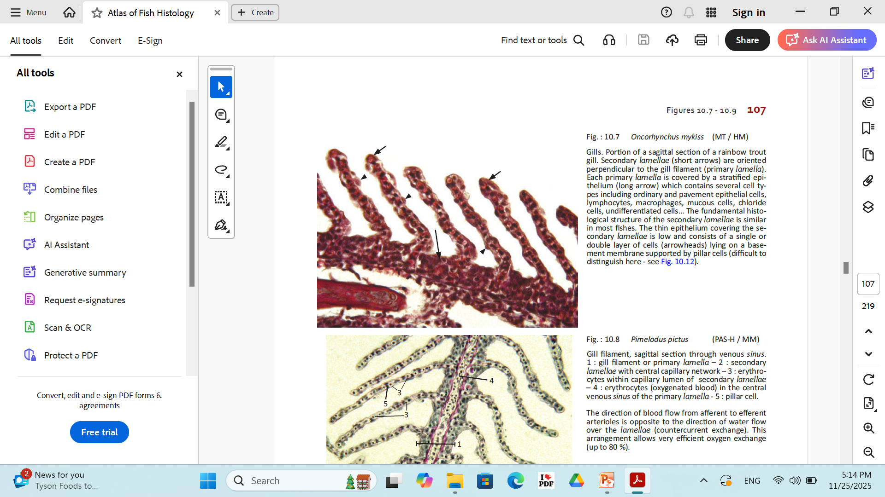

Slide 41
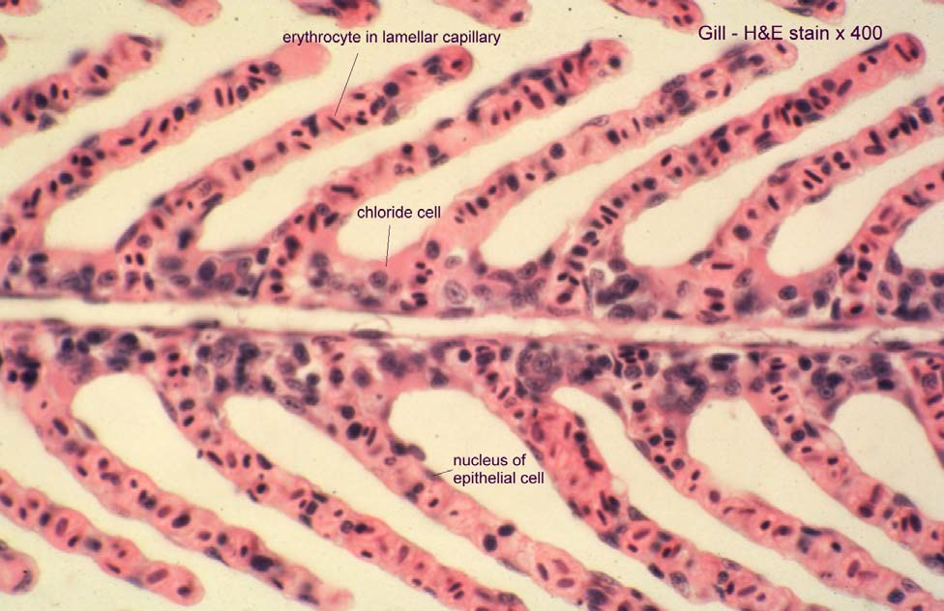

Slide 42
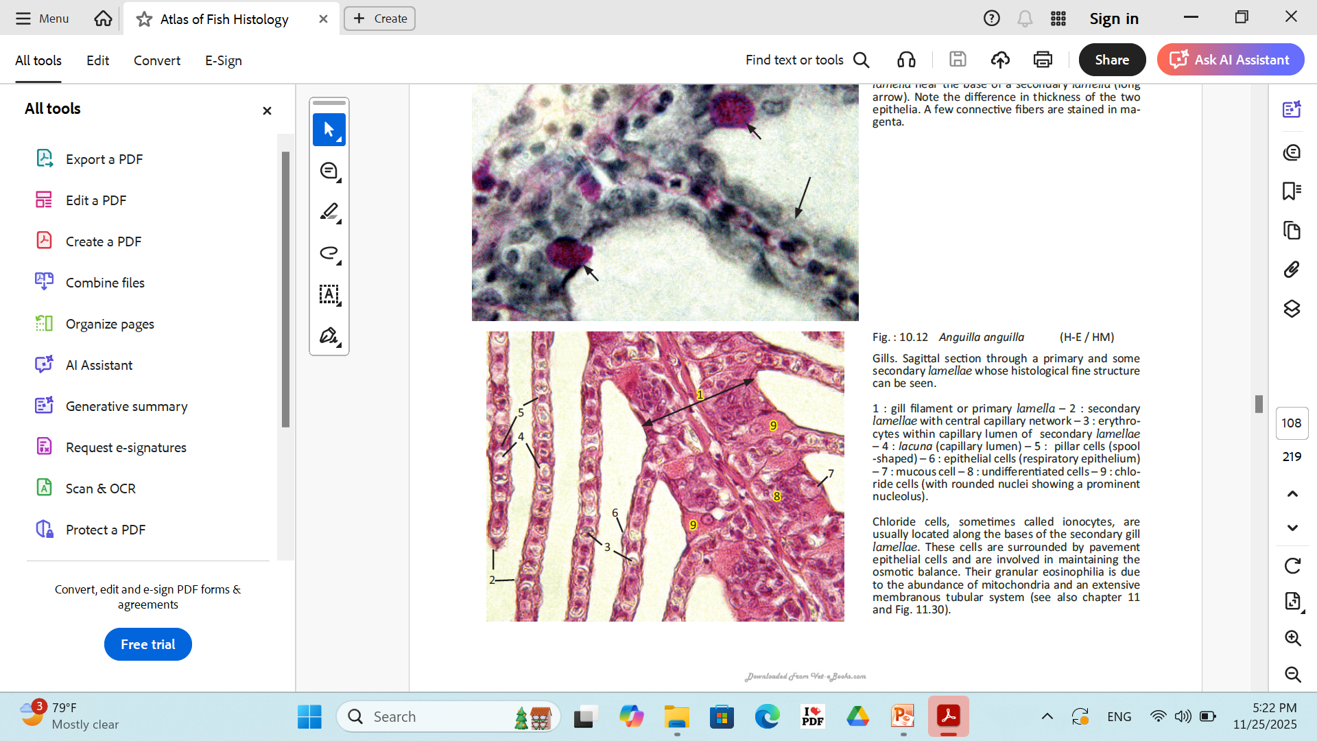

Slide 43
The Urinary System
Kidney
Location: The kidney of fish is usually located in a retroperitoneal position up against the ventral aspect of the vertebral column.
Shape: It is a light or dark brown or black organ normally extending the length of the body cavity.

Slide 44
kidney Function
Hematopoietic
Phagocytic
Endocrine and excretory elements.

Slide 45
Freshwater fish kidney is to produce copious dilute urine to counteract the passive influx of water across the gills and integument.
Fluid loss is limited in saltwater fish by reducing the size and number of glomeruli.
saltwater fish need to conserve fluid and this is achieved through modifications in the histology of nephrons.
The glomeruli are smaller and the intermediate segment is absent. The requirement. The distal segment is also often absent.

Slide 46
The ureters
which conduct urine from the collecting ducts to the urinary papilla, may fuse at any level and may be dilated, after fusion, to form a bladder.
The urinary ducts open to the outside posterior to the anus.

